Slide 1
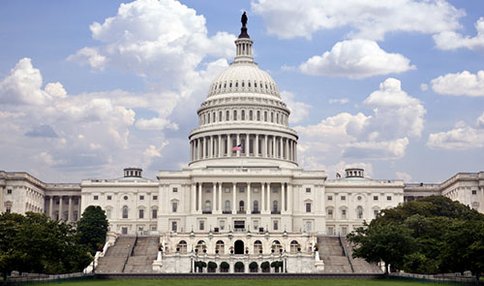
Running for Congress
CJ Cayanan, Meagan Crisostomo, Gina Nakagawa, Brian Yoo

Slide 2
Candidate Profile
Name: Lealani Dole
Age: 36
Race: Hawaiian/White
Education: BA political science Haverford College Law Degree Harvard University
Experience: Mayor of Honolulu – 4 years
Governor of Hawaii – 4 years
Party Affiliation: Republican

Slide 3
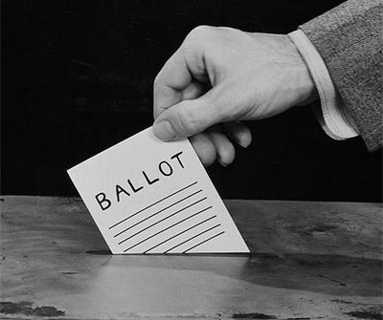
Running a campaign
Run campaign differently
Gain Visibility
Gain Distinction
Gain Popularity
Win Votes

Slide 4
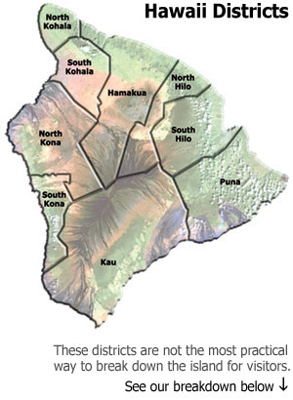
Factors
Nature of district or state
Incumbent or Challenger
Strength of personal organization
Popularity
Money

Slide 5
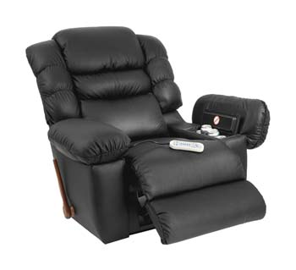
Adversity
Partisan Gerrymandering: 2002 redistricting were drawn in ways that enhanced the reelection prospects of incumbents or one party.
Safe Seats: When officeholders don’t have to fight to retain their seat.

Slide 6
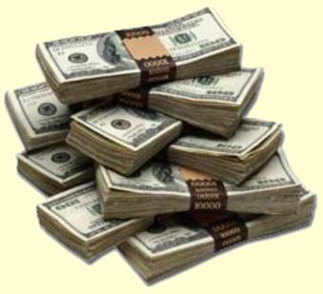
Money?!
Competition is more likely when both candidates have adequate funding.
Governor/Senate elections are more funded than U.S. house elections.

Slide 7
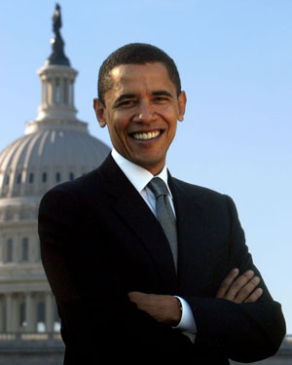
Obama and midterm elections 2010
Coattail Effect: The boost candidates from the president’s party get from running along with a popular presidential candidate.
Midterm elections depend on president’s term/situation.

Slide 8
House of Representatives

Slide 9
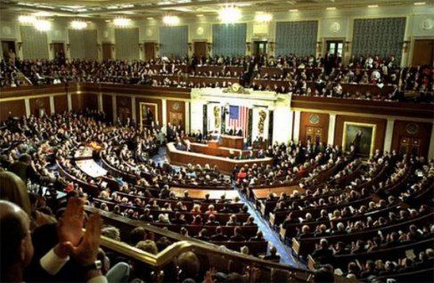
How often can I run for this position?
There is no limit on how many years one can run for the position
Every 2 years about 1,000 candidates campaign for Congress

Slide 10
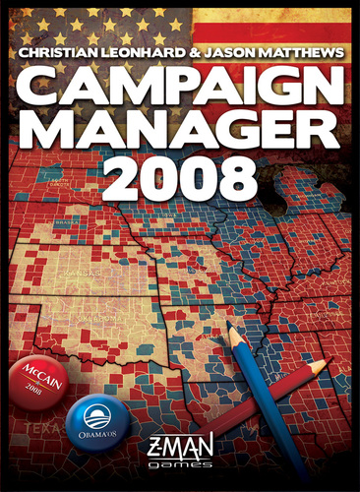
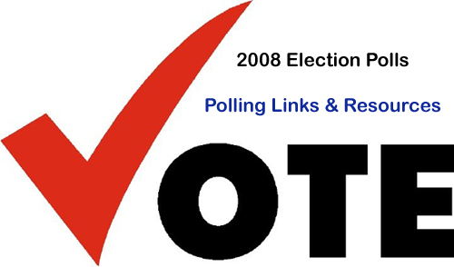
Why do I need to get more money?
Hiring campaigning managers and technicians
Buy television and other advertising tools
Conduct polls
Pay for a variety of activities

Slide 11
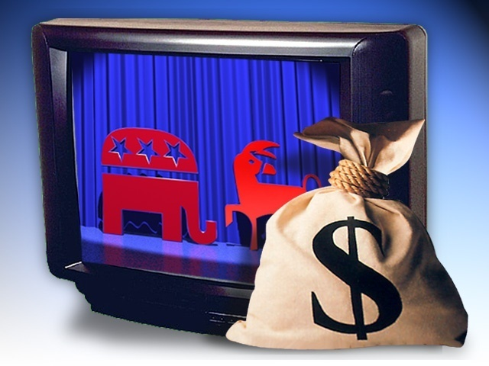
Can I ask my party to help me win?
Parties can sometimes help HOWEVER…
They shy away from giving money in primary contests
They usually stay neutral until nomination is decided

Slide 12
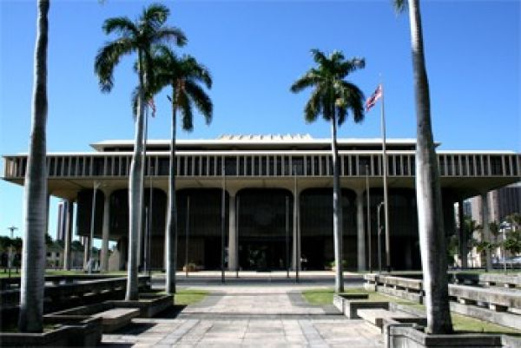
Why and how should I build a “personal organization?”
A Congressional candidate can build an organization while holding another office such as
A seat in the legislature
Serving in civic causes
Helping other candidates
Being conspicuous without being controversial

Slide 13
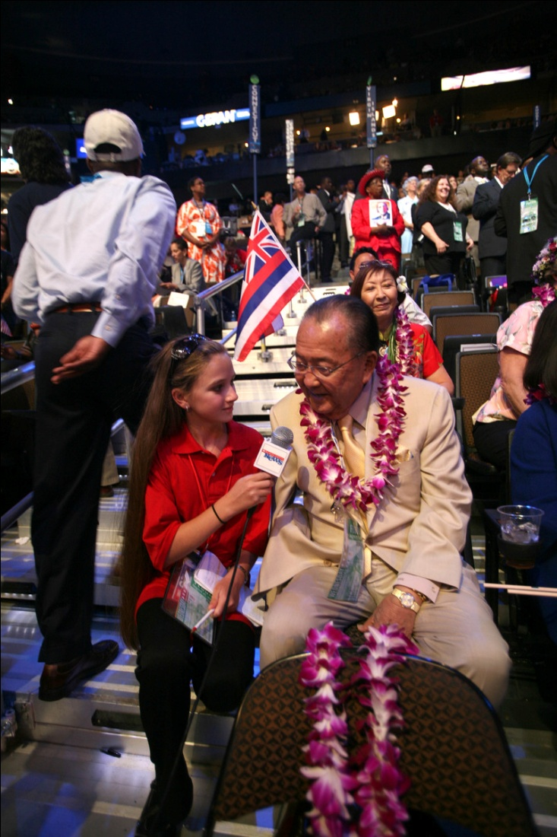
What is my main hurdle in this part of the campaign?
Gaining Visibility
-Works hard to be mentioned by the media
-Rely on personal contacts (shaking hands and door-to-door campaigning
Identifying supporters and courting their favor

Slide 14
General Election

Slide 15
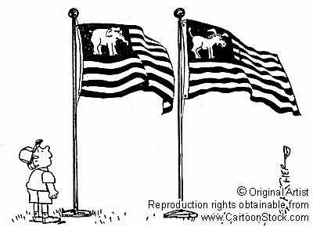
Campaign Policy
Focus on political parties
Either emphasize or deemphasize
Focus on strengths and weaknesses
Background
Experience
Visibility

Slide 16
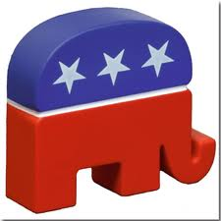
Your Political Party
If your party is affected by a negative issue:
We try to differentiate you from your party

Slide 17
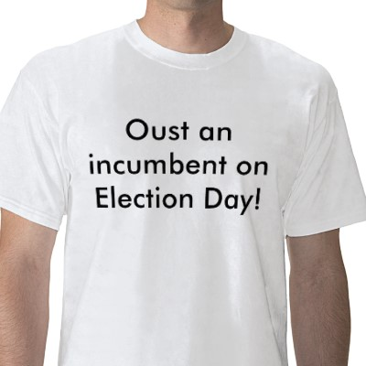
Incumbents
Incumbent – a person who already has the position but is running again
Incumbents tend to win because the people in their district are already familiar with them
Incumbents win the majority of the time
Even if the incumbents usually win, you should still run because the people might want another person to represent them

Slide 18
Senate

Slide 19
How often can I run for this position?
No limit on the number of times you can run for Senator

Slide 20
More Prestigious
6 year term
Only 2 senators per state
National exposure
More intense competition
Campaigns cost more

Slide 21
What should you do to win?
Raise a large amount of money
Hire professional and experienced campaign staff
Make as many personal contacts as possible
Avoid giving the opposition positive publicity
Have a clear and consistent campaign theme

Slide 22
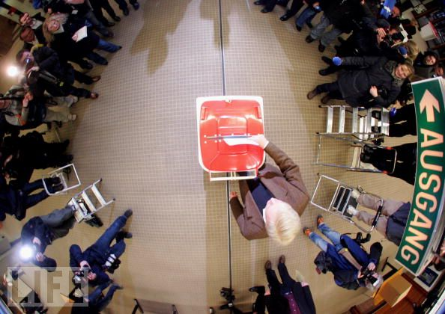
Chances when not an incumbent
Not a higher chance than an incumbent
Yet it is not as influential as when you are running for the house of representatives
Incumbent senators are widely known
But so are there opponents
Spend large sums of money

Slide 23
How does the state I am running for affect campaign finances?
Campaigns cost more in larger states
California 70 times number of potential voters than Wyoming
Interest parties direct more money to competitive races in smaller states
Campaign dollars reach more voters
Personal contacts influence greater in smaller states

